Slide 1
HAND WRITTEN MODEL USING GAN
Done by,
Sirisha N 210921104048
CSE 3rd Year
Loyola Institute of Technology
Palanchur , Chennai-123

Slide 2
AGENDA
Problem Statement
Project overview
Who are end users
Solution and Value proposition
The wow feature in solution
Modeling
Result

Slide 3
PR0BLEM STATEMENT
Existing handwritten generation methods lack diversity and realism, limiting their applicability in various domains. Current models often produce simplistic or repetitive outputs, failing to capture the intricacies of human handwriting. This hampers research in areas like document analysis, art generation, and educational material creation. There's a clear need for a more advanced solution that can generate diverse and lifelike handwritten content efficiently.

Slide 4
PROJECT OVERVIEW
This project aims to create a realistic handwritten model using Generative Adversarial Networks (GANs).
Leveraging advanced machine learning techniques, our goal is to generate diverse and high-quality handwritten content.
By training the model on a large dataset of handwritten samples, we aim to overcome limitations of existing methods.
The generated content will be useful for various applications such as data augmentation, artistic creation, and educational materials.
Our approach focuses on enhancing the authenticity and diversity of the generated handwriting.
Through this project, we seek to provide a valuable tool for researchers, artists, and educators in need of realistic handwritten data.

Slide 5
WHO ARE END USERS
The end users for the Handwritten Model Using GAN project could include a diverse range of individuals and professionals who can benefit from realistic handwritten content generation. Some potential end users may include:
1. Researchers
2. Artists
3. Educators
4. Graphic designers
5. Writers
6. Software developers
7. Students

Slide 6
SOLUTION AND ITS VALUE PROPOSITION
Solution:
Our solution leverages Generative Adversarial Networks (GANs) to create a novel approach to generating handwritten content. GANs consist of two neural networks, a generator and a discriminator, which compete against each other in a game-like setting. The generator learns to produce realistic handwritten images, while the discriminator learns to distinguish between real and generated samples. Through this adversarial process, the generator continually improves its ability to generate lifelike handwritten text..

Slide 7
VALUE PROPOSITION
1. Diverse and Realistic Handwritten Content
2. Enhanced Creativity and Flexibility
3. Time and Cost Efficiency
4. Accessibility and Scalability

Slide 8
THE WOW IN SOLUTION
1. Style Transfer Capability:
Our GAN-based handwritten model possesses the unique ability to transfer styles between different handwriting samples, enabling users to seamlessly generate diverse handwritten content while preserving individual writing characteristics.
2. Interactive Generation Interface:
Our solution incorporates an intuitive user interface that allows users to interactively control and manipulate various aspects of the handwriting generation process, providing a personalized and engaging experience unmatched by traditional methods.

Slide 9
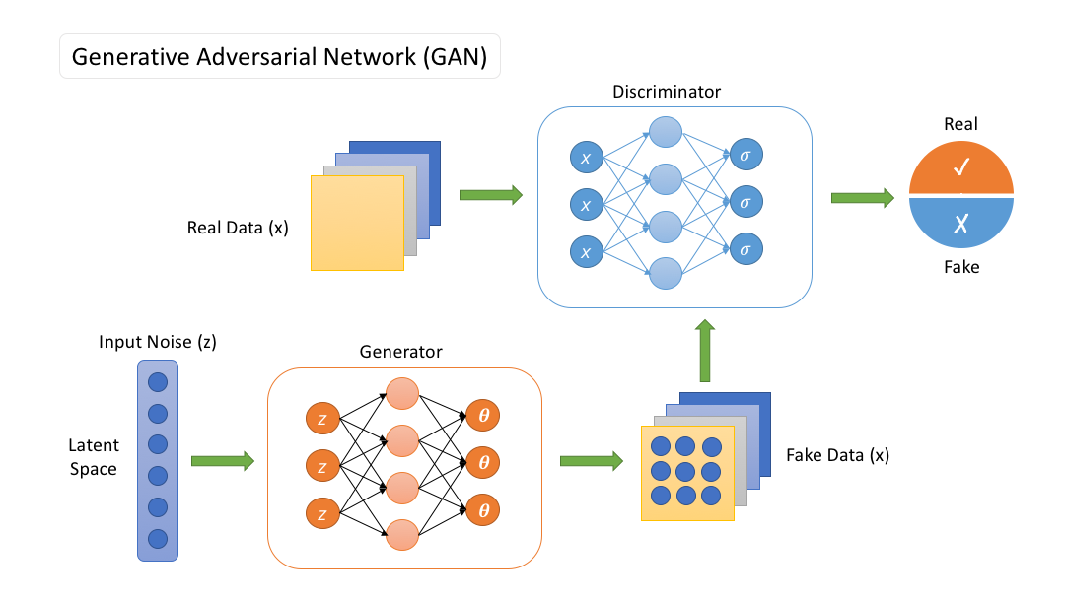
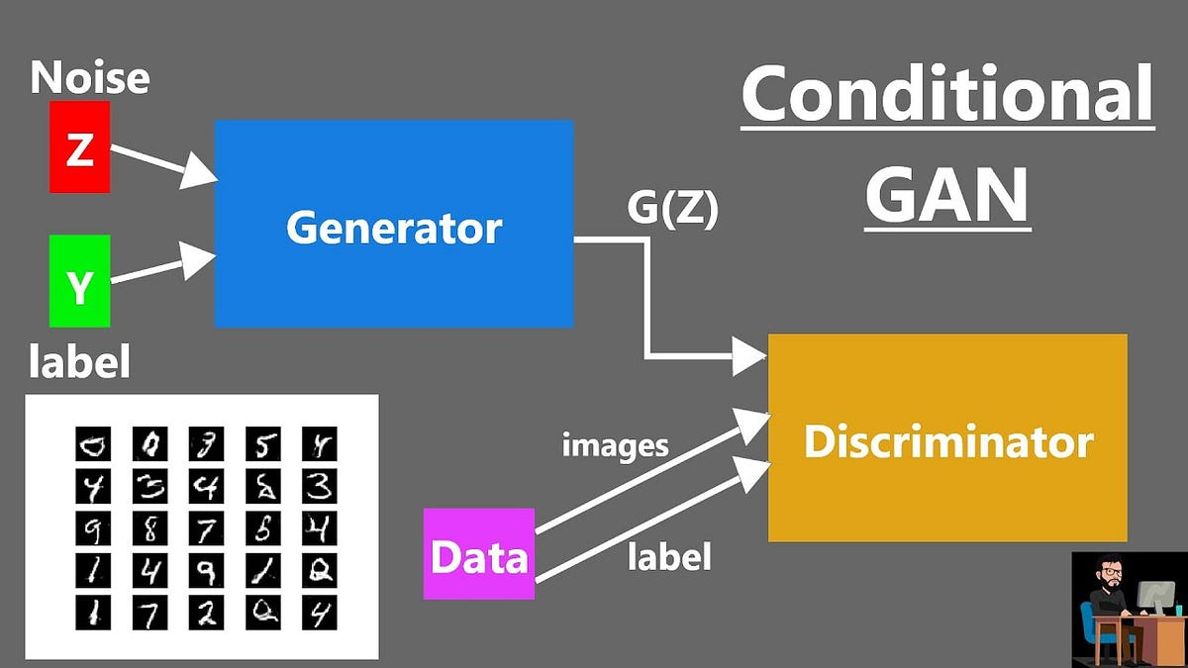
MODELLING

Slide 10
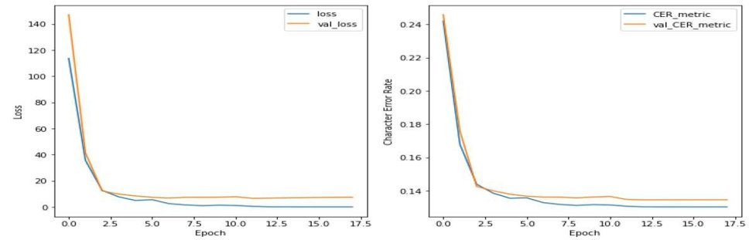
RESULT

Slide 11
